Slide 1

Title slide + image
Primevision
Progress Update
G1

Slide 2
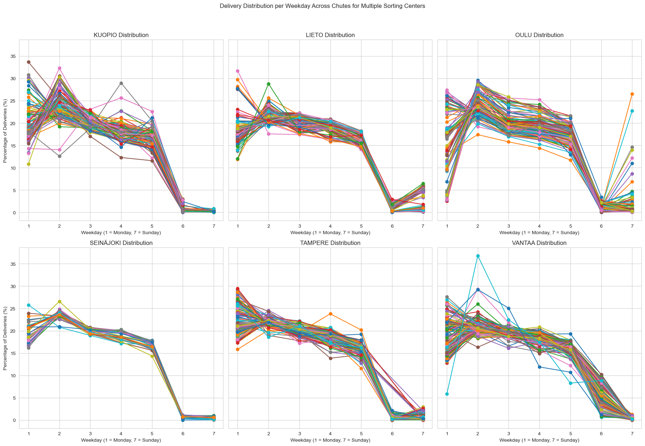

Slide 3
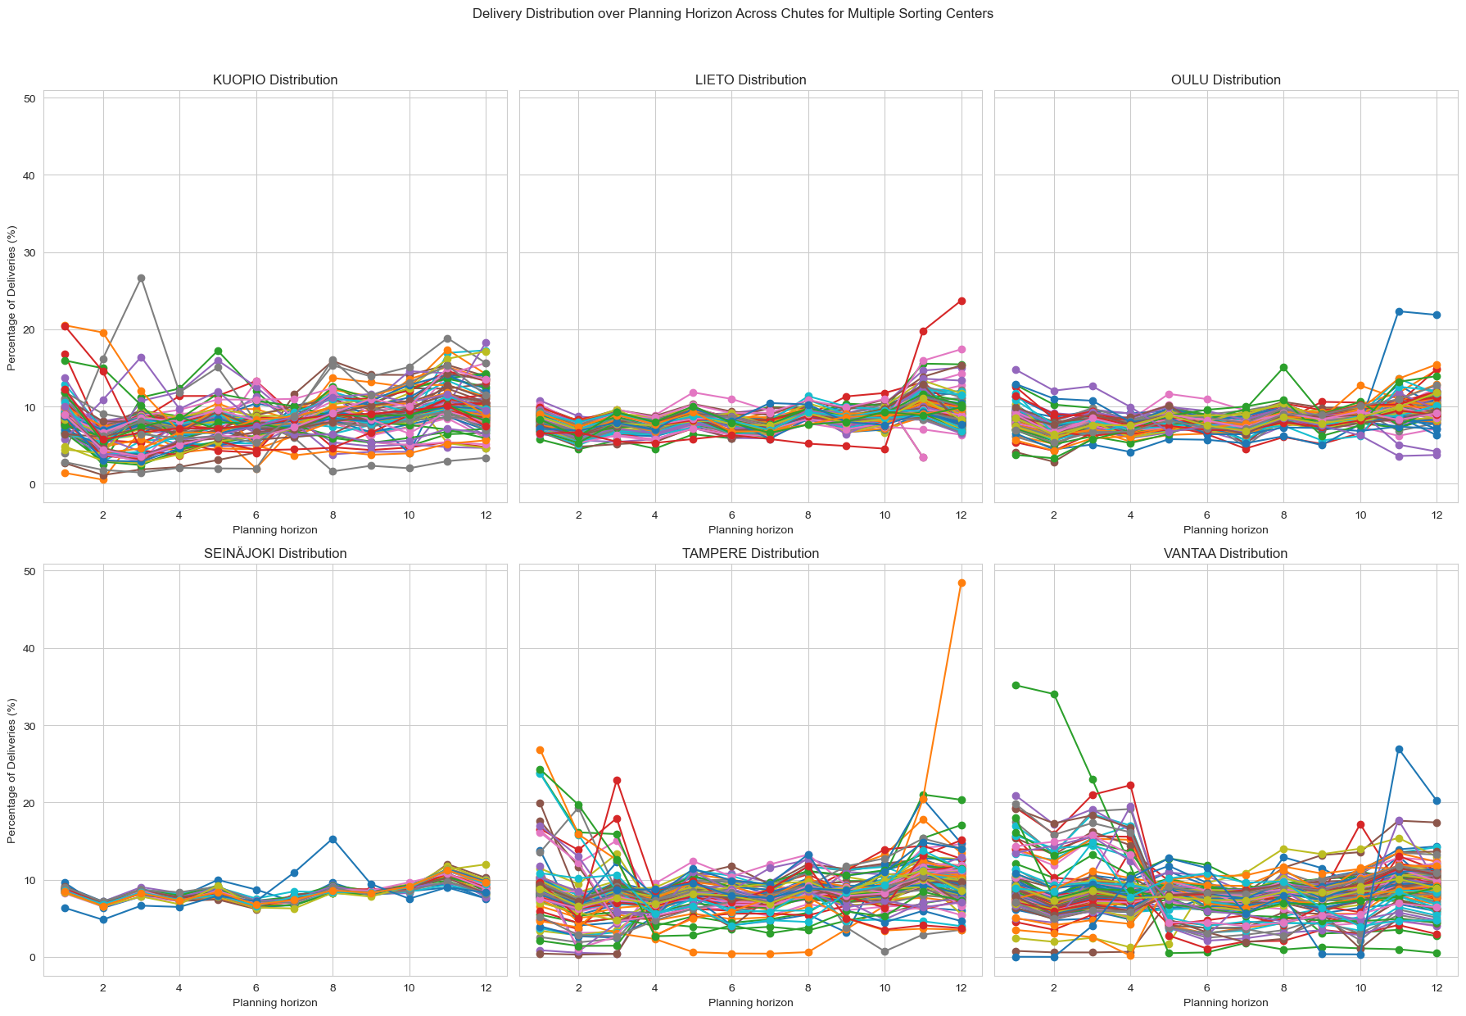

Slide 4
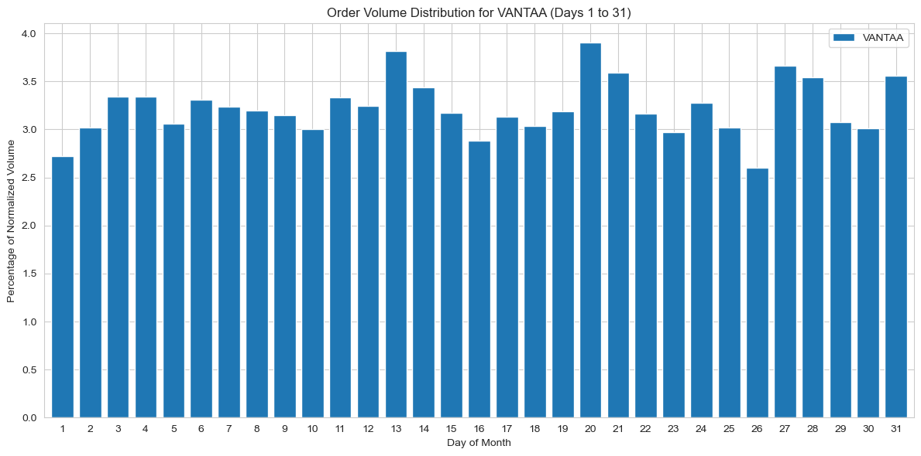
Example of order amount (normalized)

Slide 5
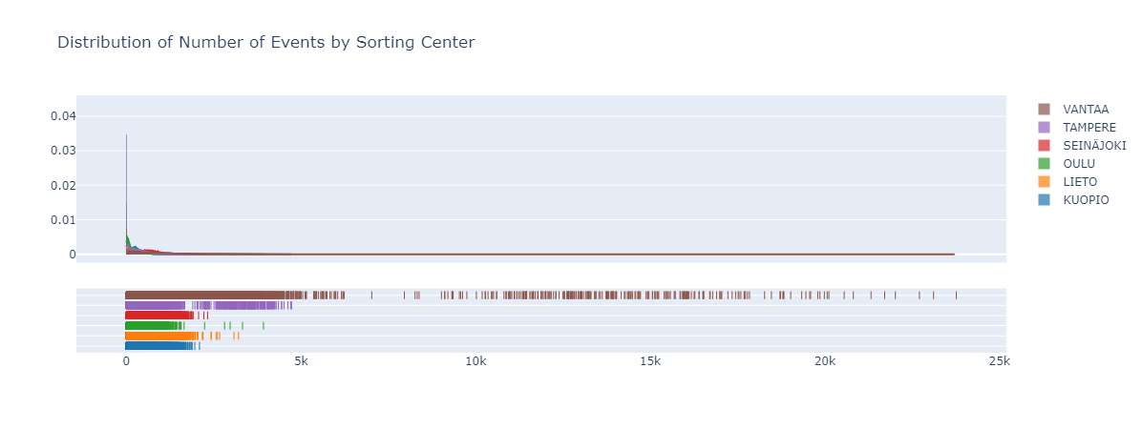
Distribution of amount of events

Slide 6
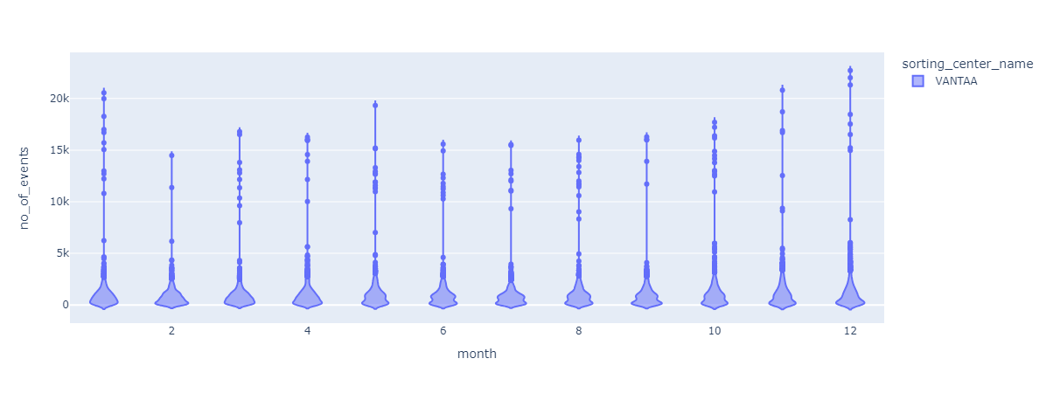
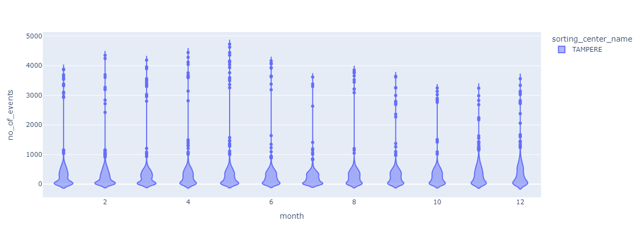
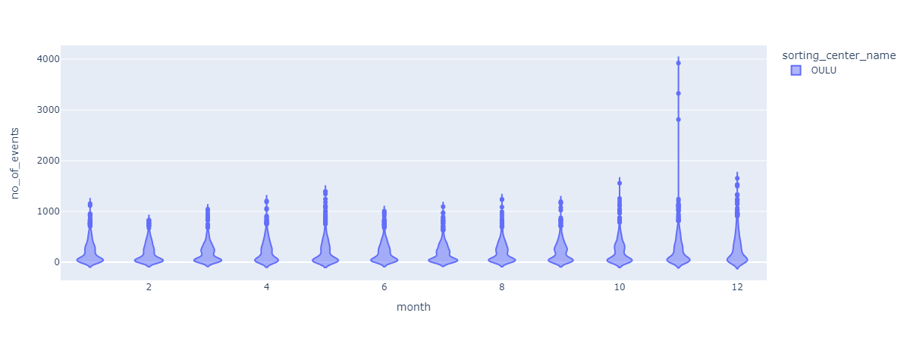
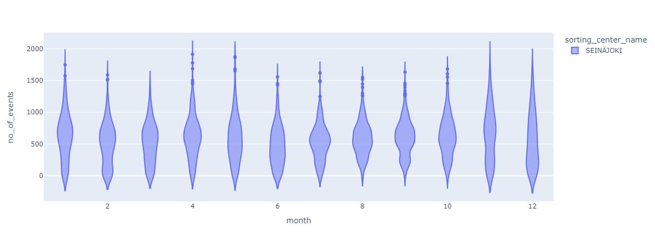
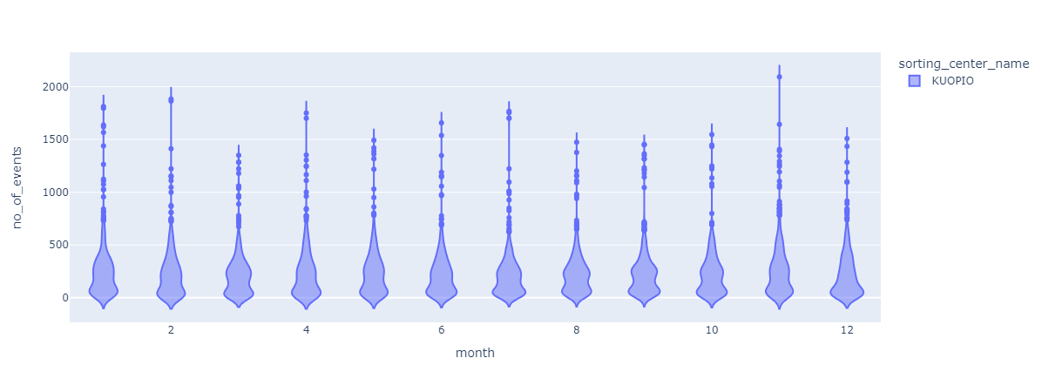
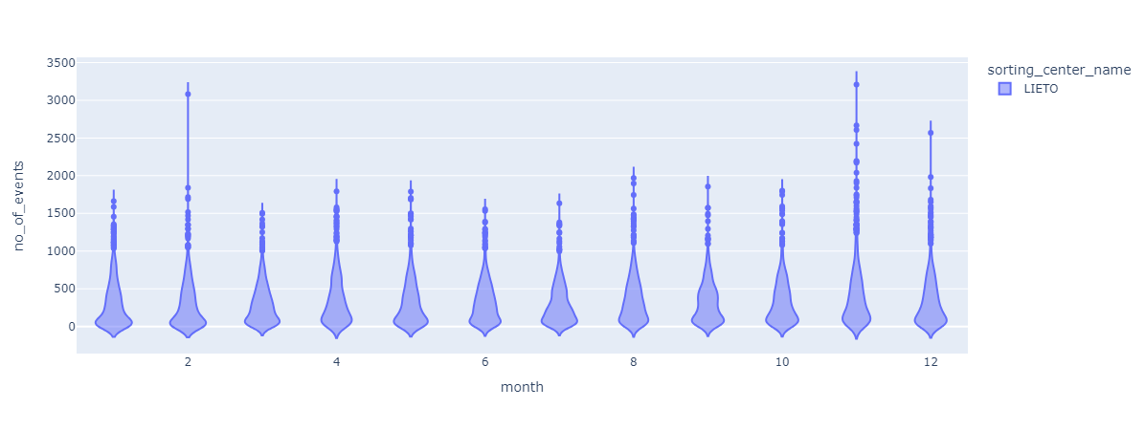

Slide 7
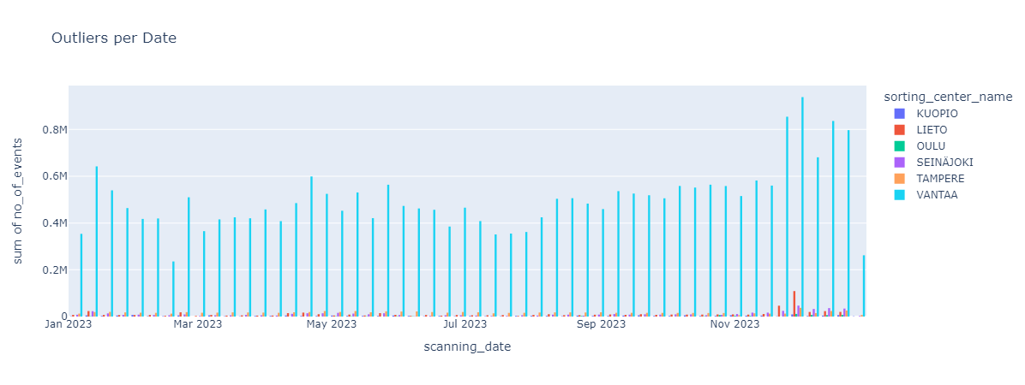
Outlier distribution

Slide 8
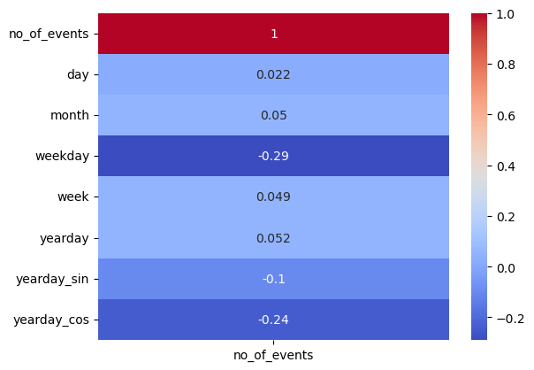
Correlation variables

Slide 9

Conclusions so far
Very low correlation between number of events and days, weeks and months
Especially VANTAA has extreme outliers at (set intervals?)
SEINÄJOKI is the easiest to predict for

Slide 10
Three models chosen
Linear regression
NN
LSTM
ARIMA

Slide 11
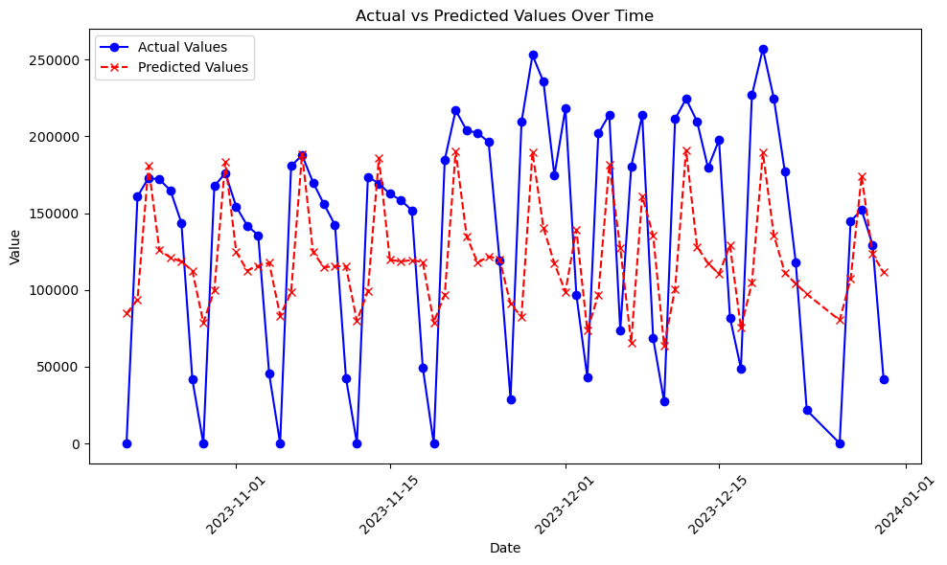
Linear regression

Slide 12
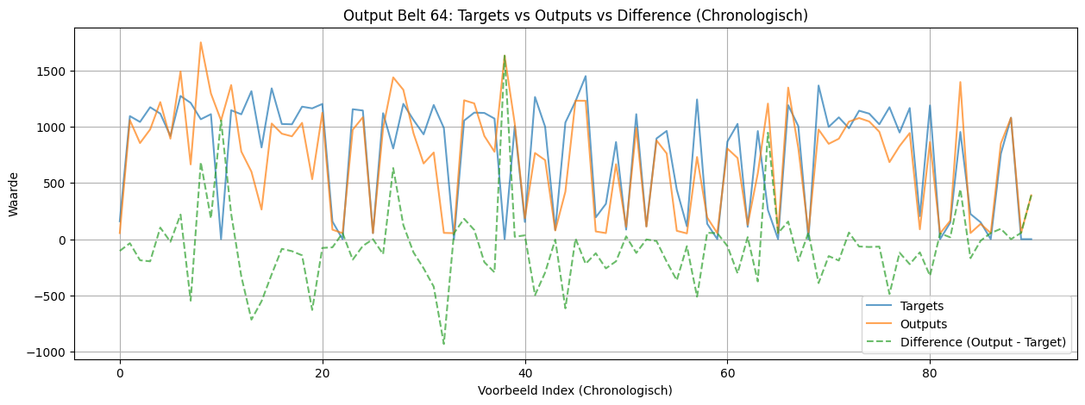
Neural Network

Slide 13
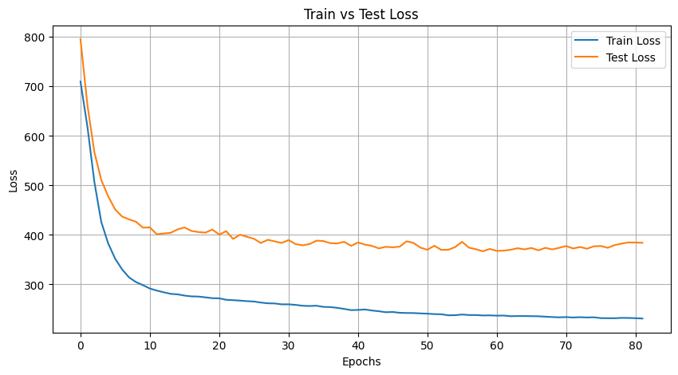

Slide 14
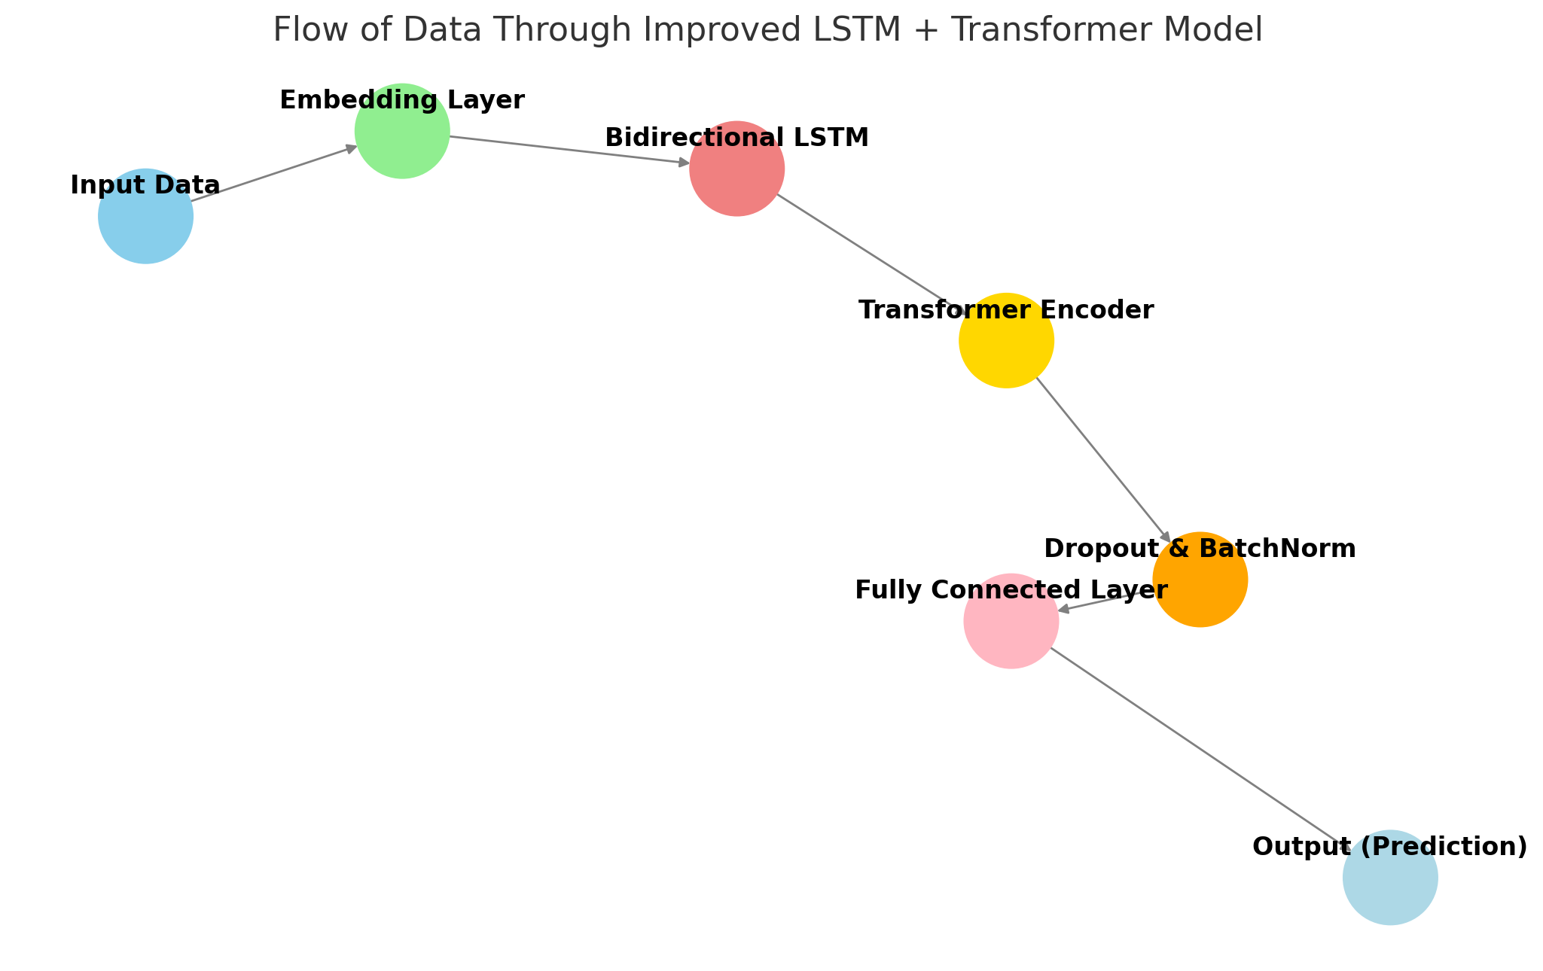
Improved LSTM + Transformer Model for Parcel Prediction
1. Model Components:
Input Data ➡️ Embedding Layer: Encodes sorting center info.
Bidirectional LSTM: Captures long-term dependencies in both time directions.
Transformer Encoder: Self-attention to enhance feature extraction.
Dropout & Batch Normalization: Regularizes and stabilizes training.
Fully Connected Layer: Outputs final predictions.
2. Key Innovations:
Hybrid Architecture: Combined LSTM (to capture long-term memory) with a Transformer (for attention).
Custom Loss Function: Added penalty for negative predictions to ensure non-negative outputs.
Overfitting Control: Used L2 Regularization (weight decay) and Dropout.
Learning Rate Scheduler: Adjusts the learning rate during training for better convergence.
Huber Loss: Reduces the impact of outliers for a more robust model.

Slide 15
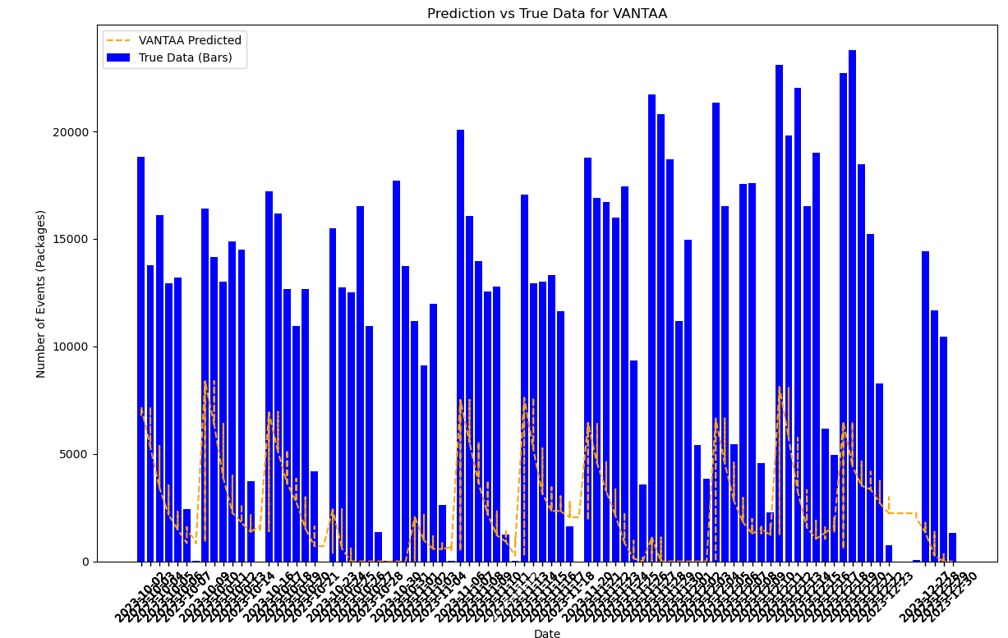
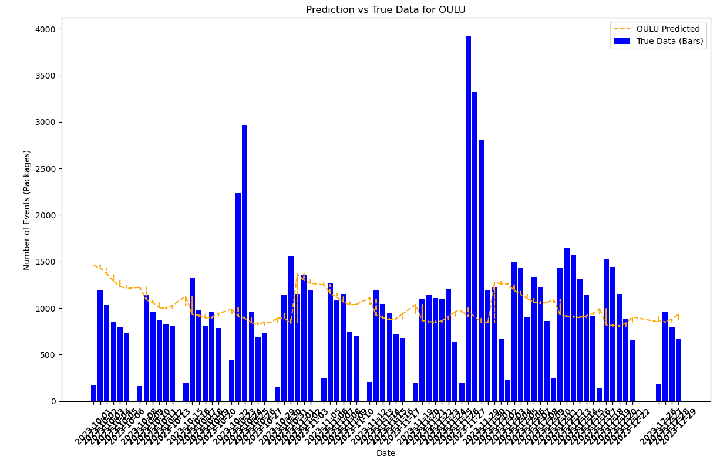
Results, Challenges, and Future Improvements
1. Results Description:
Underfitting.
Poor Generalization
2. Challenges & Limitations:
Data Volatility: High variability and sudden spikes are difficult to predict, especially with unexpected events.
Lack of Seasonality: Limited to only one year of data, which makes it hard to effectively capture seasonal patterns.
Outliers: Visual analysis reveals significant outliers that impact predictions. These were retained as they might indicate special events or days.
3. Future Improvements:
Feature Expansion: Include data such as promotions and external influences such as weather conditions, or historical moving averages.
Model Complexity Adjustment: Include more LSTM units/layers or simplify the model structure (e.g., using only LSTM or Transformer).
Outlier Management: A balanced approach to outlier detection—removing clearly erroneous points while preserving significant rare events.
Figure. Part of the results from initial models: first 9 months for training, last 3 months for testing

Slide 16
ARIMA
AutoRegressive (AR)
AR(p) refers to the autoregressive part of the model
Future value is regressed on its own previous values
p represents the number of lagged observations included
Integrated (I)
I(d) represents the number of times the data have been differenced to make the time series stationary
d is often 1
Moving Average (MA)
MA(q) refers to the moving average part of the model
forecast error is regressed on previous forecast errors
q represents the number of lagged forecast errors included in the model.
ARIMA(p, d, q) models both the past values (AR) and past errors (MA) to make predictions

Slide 17
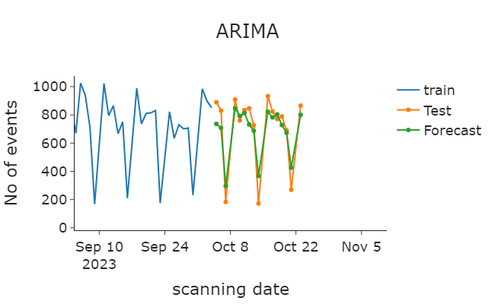
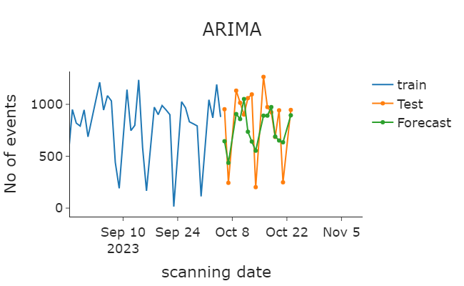

Slide 18
Future steps
Improve the models
Outlier management
Feature engineering
Hyperparameter tuning
Analyse results
Discuss best option

Slide 19
Afsluiter
Thanks for listening!

